Slide 1

The Property Inspector in depth

Slide 2
The Property Inspector in depth
Cyrille Fauvel
Developer Technical Services
Autodesk Consulting
  AutoCAD / AutoCAD OEM / ObjectDBX
  Inventor
  Soon MapGuide
  C++ (ATL/MFC) / C# / Java / SQL / Php

Slide 3
The Property Inspector in depth
Agenda
  What is the Property Palette?
    Extending the Property Inspector for existing entities
    Enabling the Property Inspector for your custom entities
    Jig class
  What interface for which feature?
  Sample (with code)
  Q & A

Slide 4
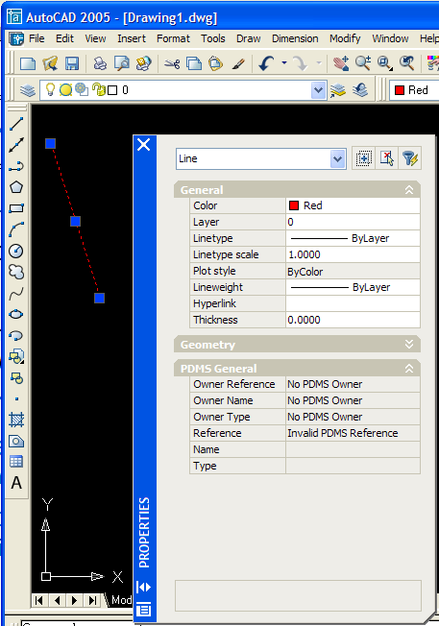
What is the Property Inspector?
Command: _PROPERTIES
It is the dock-able Window
3 modes:
  Drawing defaults (no selection)
  Command options (I.e.: _3DORBIT)
  Object properties (single or multiple selection)
Object properties are displayed either
  Alphabetically
  or by Category

Slide 5
What is the Property Inspector?
It has been fully rewritten in 2004 to offer more powerful features (see ADT)
It is all COM programming
It displays Static & Dynamic properties
  Of an object
  Of a collection of objects

Slide 6
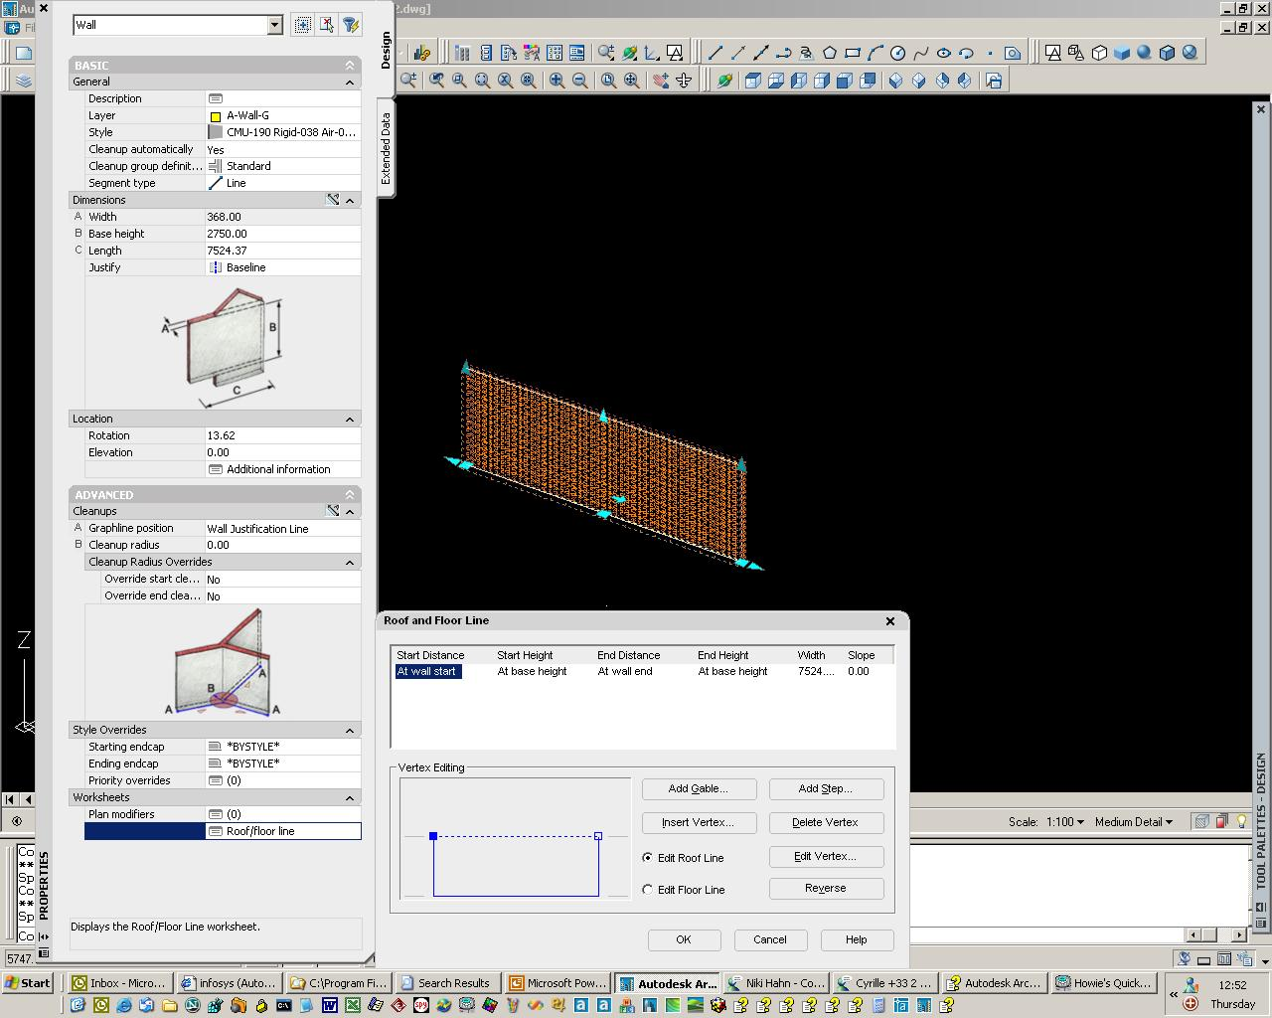
What is the Property Inspector?

Slide 7
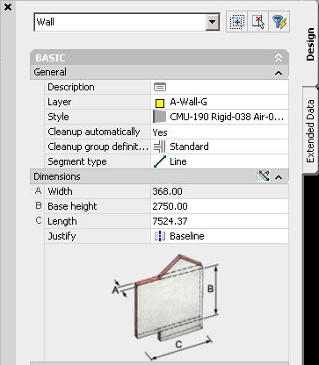
What is the Property Inspector?
Categories & sub-categories
Preview / images
Buttons and dialogs
Custom controls
Notes:
The Compiled app is compiled into an Intermediate language which is not run directly on the OS, but run from the CLR which in turn invokes the OS specific JIT compiler.

Slide 8
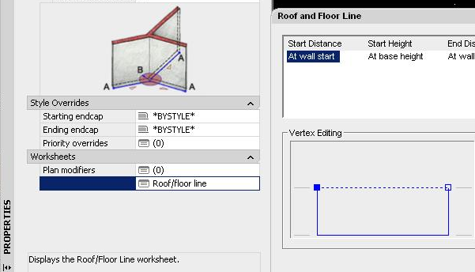
What is the Property Inspector?

Slide 9
Static & Dynamic Properties
Static Properties (I.e. Color)
  Properties of the object
  Defined at compile time
  Values are saved in the object
Dynamic Property (I.e. Price)
  Additional property to an object
  Added at runtime
  Value is not stored in the object itself

Slide 10
Static Properties
Is for custom entity
  Implement getClassID() to return the coclass’ CLSID
  Implement a COM wrapper Interface to represent your object.
    This will enable your entity to be accessible from VB(A) and COM client applications
    ATL and IDispatch usage recommended

Slide 11
Static Properties
The AutoCAD Property Inspector
  Ask selected object to return the coclass’ CLSID which represent the COM incarnation of the object
  From the registry, retrieve the COM server type library file describing the server object
  Reads the type library information to retrieve the ‘Static’ properties of the object
    Retrieves their types, status (I.e. read-only, …) and current values, …
    And follows inheritance

Slide 12
Static Properties
[
object,
uuid(4D207519-0CA3-48DF-989B-138597D289E9),
dual,
nonextensible,
pointer_default(unique)
]
interface IMyComObject : IAcadEntity {
[propget, id(1)]
HRESULT MyProp([out, retval] DOUBLE* pVal);
[propput, id(1)]
HRESULT MyProp([in] DOUBLE newVal);
};

Slide 13
Static Properties
[
uuid(44C5C3DB-E273-48C3-8A32-BCD6BD712485)
]
coclass MyComObject
{
[default] interface IMyComObject;
[source] interface IAcadObjectEvents;
};

Slide 14
Static Properties
Supporting VB(A), immediately make your entity to support the Property Inspector ☺
Simple types are easy to implement. However complex type requires more coding.
Sometimes a Custom Control is required.
You are working in the Application Context, so document locking required

Slide 15
Dynamic Properties
Is for any entity type
  Implementation based on PEX technology
  Implement a COM Interface representing the Property
  Register it for a given AutoCAD class descriptor
  (one or many)

Slide 16
Dynamic Properties
When AutoCAD has finished to retrieve Static Properties, it
  Looks into the AutoCAD class hierarchy for an OPM Protocol Extension (PEX) for Dynamic Properties
  Retrieves the CLSID of the COM interface from the PEX object
    It uses inheritance
  OPM calls COM wrapper interface methods to retrieve the property definition
    Retrieves its types, status (I.e. read-only, …) and current values, …

Slide 17
Dynamic Properties
Where to store values?
  XData
    Visible by all (public data)
    Limited to 16kb (shared by all application
  Extension Dictionary
    Private data
    Unlimited size
    Easy access
    Be careful about DWG size for this one
    (2 * 300 bytes + data size) * number of object in DWG
    (2 * 300 + 8) * 1000 / 1024 = 593.75 kb for a double
  Named Object Dictionary

Slide 18
Property Inspector
When Static & Dynamic Properties are all found, AutoCAD
  Categorize
  Sort
  Hide / Show
  Disable / Enable
  …
all properties and display the result.
But how does it knows what he has to do?

Slide 19
Property Inspector (Static Properties)
IDL
  importlib("axdb16enu.tlb")
  IAcadObject
    Base interface for non-entity type
  IAcadEntity
    Base interface for entity type
  IAcadObjectEvents
    Base interface for AutoCAD object events
What about other AutoCAD interfaces?
  I.e. IAcadCircle

Slide 20
Property Inspector (Static Properties)
Required Interfaces
  IRetrieveApplication
    Keep a connection to the host application
    (I.e. IAcadApplication)
  IAcadBaseObject / IAcadBaseObject2
    Implements the based interfaces
    IAcadbaseObject2 is for support of non-database resident object
  IAcadObjectEvents
    AutoCAD events such as OnModified / OnErased / …
  IPropertyNotifySink
    Microsoft Interface for property events
    (OnChanged / OnRequestEdit)

Slide 21
Property Inspector (Static Properties)
public IAcadObjectDispatchImpl<CMyComObject, …
  For non-entity types
public IAcadEntityDispatchImpl<CMyComEntity, …
  For entity types
Introduces member:
  AcDbObjectId m_objId;

Slide 22
Property Inspector (Static Properties)
//- IAcadBaseObject
STDMETHOD(CreateNewObject) (AcDbObjectId &objId, AcDbObjectId &ownerId, TCHAR *keyName);
//- IAcadBaseObject2
STDMETHOD(ForceDbResident) (VARIANT_BOOL *forceDbResident) ;
STDMETHOD(CreateObject) (AcDbObjectId ownerId =AcDbObjectId::kNull, TCHAR *keyName =NULL);
STDMETHOD(AddToDb) (AcDbObjectId &objId, AcDbObjectId ownerId =AcDbObjectId::kNull, TCHAR *keyName =NULL);

Slide 23
Property Inspector (Static Properties)
ICategorizeProperties
  To map a property to a category
IOPMPropertyExtension
  Controls display / appearance of a property
IPerPropertyBrowsing
  Microsoft interface required for categorization of properties
public IOPMPropertyExtensionImpl<CMyComObject>

Slide 24
Property Inspector (Static Properties)
//- ICategorizeProperties
STDMETHOD(MapPropertyToCategory)(DISPID dispid, PROPCAT *ppropcat);
STDMETHOD(GetCategoryName)(PROPCAT propcat, LCID lcid, BSTR *pbstrName);
//- IOPMPropertyExtension
STDMETHOD(GetDisplayName)(DISPID dispID, BSTR *propName);
STDMETHOD(Editable)(DISPID dispID, BOOL __RPC_FAR *bEditable);
STDMETHOD(ShowProperty)(DISPID dispID, BOOL *pShow);
//- IPerPropertyBrowsing
STDMETHOD(GetDisplayString)(DISPID dispID, BSTR *pBstr);
STDMETHOD(MapPropertyToPage)(DISPID dispID, CLSID *pClsid);
STDMETHOD(GetPredefinedStrings)(DISPID dispID, CALPOLESTR *pCaStringsOut, CADWORD *pCaCookiesOut);
STDMETHOD(GetPredefinedValue)(DISPID dispID, DWORD dwCookie, VARIANT *pVarOut);

Slide 25
Property Inspector (Static Properties)
Default implementation uses the
BEGIN_OPMPROP_MAP()
END_OPMPROP_MAP()
(you can override methods if you want)
    OPMPROP_ENTRY
    OPMPROP_CAT_ENTRY
    OPMPROP_DESC_ENTRY
    OPMPROP_PREDEFINED_ENTRY
    OPMPROP_ELEMENT_ENTRY
    OPMPROP_PAGE

Slide 26
Property Inspector (Static Properties)
IOPMPropertyExpander / IOPMPropertyExpander2
  Breaks one property into several lines (useful for points)
  Really works for points only until now ☹
IOPMPropertyExpander2 can be used for Static and Dynamic Properties

Slide 27
Property Inspector (Static Properties)
//- IOPMPropertyExpander
STDMETHOD(GetElementValue)(DISPID dispID, DWORD dwCookie, VARIANT *pVarOut);
STDMETHOD(SetElementValue)(DISPID dispID, DWORD dwCookie, VARIANT VarIn);
STDMETHOD(GetElementStrings)(DISPID dispID, OPMLPOLESTR __RPC_FAR *pCaStringsOut, OPMDWORD __RPC_FAR *pCaCookiesOut);
STDMETHOD(GetElementGrouping)(DISPID dispID, short *groupingNumber);
STDMETHOD(GetGroupCount)(DISPID dispID, long *nGroupCnt);

Slide 28
Property Inspector (Static Properties)
//- IOPMPropertyExpander2
STDMETHOD(GetElementValue)(DISPID dispID, IUnknown *pUnk, DWORD dwCookie, VARIANT * pVarOut);
STDMETHOD(SetElementValue)(DISPID dispID, IUnknown *pUnk, DWORD dwCookie, VARIANT VarIn) ;
STDMETHOD(GetElementStrings)(DISPID dispID, IUnknown *pUnk, OPMLPOLESTR __RPC_FAR *pCaStringsOut, OPMDWORD __RPC_FAR *pCaCookiesOut);
STDMETHOD(GetElementGrouping)(DISPID dispID, IUnknown *pUnk, short *groupingNumber);
STDMETHOD(GetGroupCount)(DISPID dispID, IUnknown *pUnk, long *nGroupCnt);
‘IUnknown *pUnk’ reference to the object edited

Slide 29
Property Inspector (Static Properties)
IAcPiPropertyDisplay
  Interface to customize display properties on a per-property basis
public IAcPiPropertyDisplayImpl<CMyComObject>

Slide 30
Property Inspector (Static Properties)
//- IAcPiPropertyDisplay
STDMETHOD(GetCustomPropertyCtrl)(VARIANT Id, LCID lcid, BSTR *pProgId);
STDMETHOD(GetPropertyIcon)(VARIANT Id, IUnknown **pIcon);
STDMETHOD(GetPropTextColor)(VARIANT Id, OLE_COLOR *pTextColor);
STDMETHOD(IsFullView)(VARIANT Id, VARIANT_BOOL *pbVisible, DWORD *pIntegralHeight);
STDMETHOD(GetPropertyWeight)(VARIANT Id, long *pPropertyWeight);

Slide 31
Property Inspector (Static Properties)
Other interfaces
  IAcPiCategorizeProperties
  IAcPiPropCommandButtons
  IAcPiCommandButton
  IAcPiPropertyEditControl
  IAcPiPropertyEditEventsSink
  IAcPiPropertyInspector
  IAcPiPropertyInspectorEventsSink
  IAcPiPropertyInspectorInputEventSink
  IAcPiPropertyUnspecified

Slide 32
Property Inspector (Dynamic Properties)
IPropertyManager / IPropertyManager2
  Used to register dynamic properties
IDynamicProperty / IDynamicProperty2
  The base interface for dynamic properties
IDynamicPropertyNotify / IDynamicPropertyNotify2
  Per-instance dynamic properties for objects
  Member of your interface coclass C++ class
OPM_DYNPROP_OBJECT_ENTRY_AUTO(CMyDynProp, AcDbXXX)

Slide 33
Property Inspector (Dynamic Properties)
Other interfaces
  IDynamicDialogProperty
    Add a button to the property
  IDynamicEnumProperty
    Enumeration property
  IPropertySource

Slide 34
Property Inspector (Controls)
acpexctrl.h
AcPEXCtl.AcPePropertyEditorColor.16
AcPEXCtl.AcPePropertyEditorLayer.16
IAcPeNumericEditor
IAcPeVariantCtrl
IAcPeColorCtrl
IAcPeSpinCtrl
IAcPeNoPickVariantRW
IAcPeButtonEditCtrl
IAcPePick2PointsCtrl
AcPePropertyEditorText
AcPePropertyEditorLWeight
AcPePropertyEditorLayer
AcPePropertyEditorColor
AcPePropertyEditorLType
AcPePropertyEditorBool
AcPePropertyEditorACADNumeric
AcPePropertyEditorNumericArea
AcPePropertyEditorEllipses
AcPePropertyEditorEnum
AcPePropertyEditorHatchEnum
AcPePropertyEditorMTextDir
AcPePropertyEditorHatchISOPenWidth
AcPePropertyEditorHatchPatternName
AcPePropertyEditorEllipsisHatchPatternType
AcPeDlgLaunchCtrl
AcPePropertyEditorVariant
AcPePropertyEditorEllipsesHyperlinks

Slide 35
Working with Jig
AsdkBasePrompt<> class
Interruptible command
  ACRX_CMD_INTERRUPTIBLE
Just a MAP of properties to acquire
BEGIN_PROMPT_MAP(AsdkPieJig)
PROMPT_ENTRY(_T("Center"), 1, RT3DPOINT, 0, IDS_PROMPT_CENTER, true)
PROMPT_ENTRY(_T("Radius"), 2, RTREAL, 0, IDS_PROMPT_RADIUS, true)
PROMPT_ENTRY(_T("Title"), 100, RTSTR, 0, IDS_PROMPT_TITLE, true)
PROMPT_ENTRY(_T("Sector"), 0, RTREAL, 0, IDS_PROMPT_SECTOR, true)
END_PROMPT_MAP

Slide 36
Property Inspector
Working example
  Entity derived from AcDbCircle
    Owns one to several sub-items (like polyline vertices)
  Interface derived from IAcadCircle
    Careful with COM inheritance
    ATL specifics
    Sub-items have their own interface
    Collection implementation
    Custom Spinner control
So what is it?

Slide 37
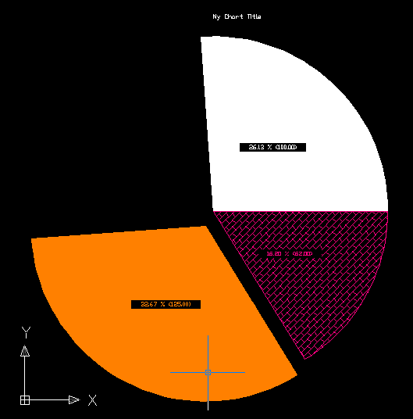
Property Inspector
Working example
For complete code
Please contact me at
cyrille.fauvel@autodesk.com

Slide 38

Questions?

Slide 39
Thank You !

